Slide 1
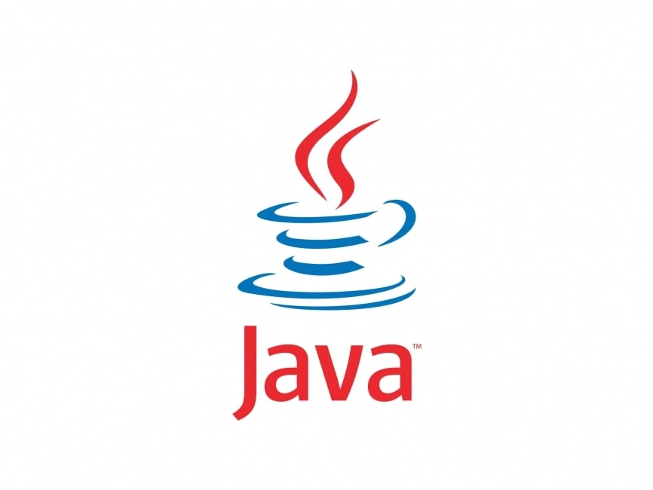
Java Architecture
A Brief Introduction of
By : - Manoj Hankare

Slide 2
Components of Java Architecture
The Java architecture includes the three main components:
Java Development Kit (JDK)
Java Runtime Environment (JRE)
Java Virtual Machine (JVM)

Slide 3
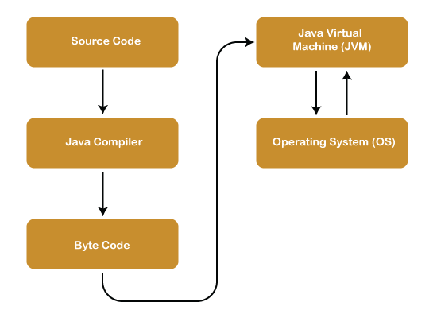
Java Architecture
Java Architecture is a collection of components, i.e., JVM, JRE, and JDK. It integrates the process of interpretation and compilation
Java Architecture can be explained by using the following steps:
There is a process of compilation and interpretation in Java.
Java compiler converts the Java code into byte code.
After that, the JVM converts the byte code into machine code.
The machine code is then executed by the machine.

Slide 4
JDK
JDK is an acronym for Java Development Kit. The Java Development Kit (JDK) is a software development environment which is used to develop Java applications and applets.
It contains JRE + development tools.
The JDK contains a private Java Virtual Machine (JVM) and a few other resources such as an interpreter/loader (java), a compiler (javac), an archiver (jar), a documentation generator (Javadoc), etc. to complete the development of a Java Application.

Slide 5
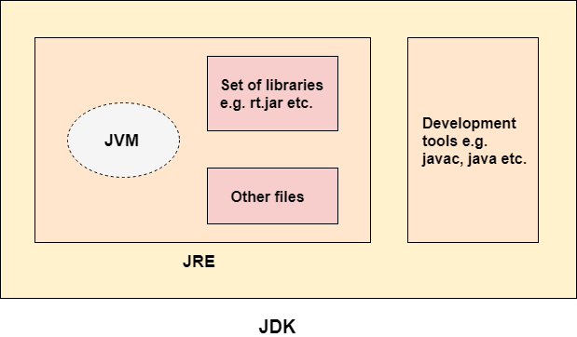

Slide 6

JDK
The Java Runtime Environment (JRE) is software that Java programs require to run correctly.
The JRE is the underlying technology that communicates between the Java program and the operating system.
The JRE combines the Java code that you create by using the JDK with additional built-in code called libraries.
It then creates a JVM instance, or local copy, that finally runs the Java programs.
JVMs are available for multiple operating systems, and the JRE generates a single copy of your Java code that runs on all types of JVMs. In this way, the JRE facilitates platform independence for Java applications. You can write them once and run them anywhere.

Slide 7
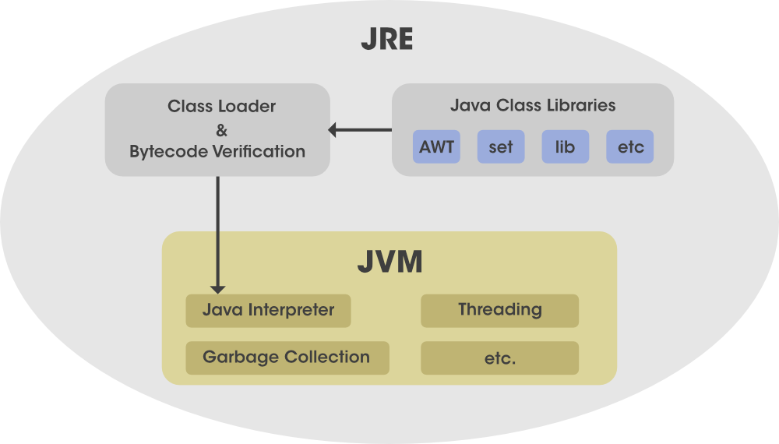

Slide 8
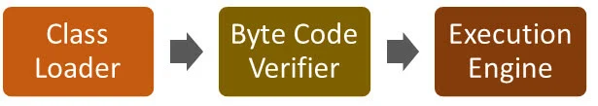
JRE ( Java Runtime Environment)
The JVM performs following operation:
Loads code
Verifies code
Executes code
Provides runtime environment
JVM provides definitions for the:
Memory area i.e. Class read area, Heap, Stack,
Class file format
Register set
Garbage-collected heap
Fatal error reporting etc.

Slide 9
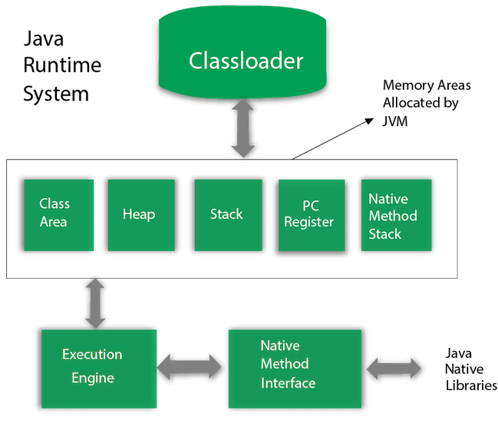

Slide 10
1) Class Loader
The class loader is a subsystem used for loading class files. It performs three major functions viz. Loading, Linking, and Initialization.
2) Method Area
JVM Method Area stores class structures like metadata, the constant runtime pool, and the code for methods.
3) Heap
All the Objects, their related instance variables, and arrays are stored in the heap. This memory is common and shared across multiple threads.
4) JVM language Stacks
Java language Stacks store local variables, and it’s partial results. Each thread has its own JVM stack, created simultaneously as the thread is created. A new frame is created whenever a method is invoked, and it is deleted when method invocation process is complete.

Slide 11
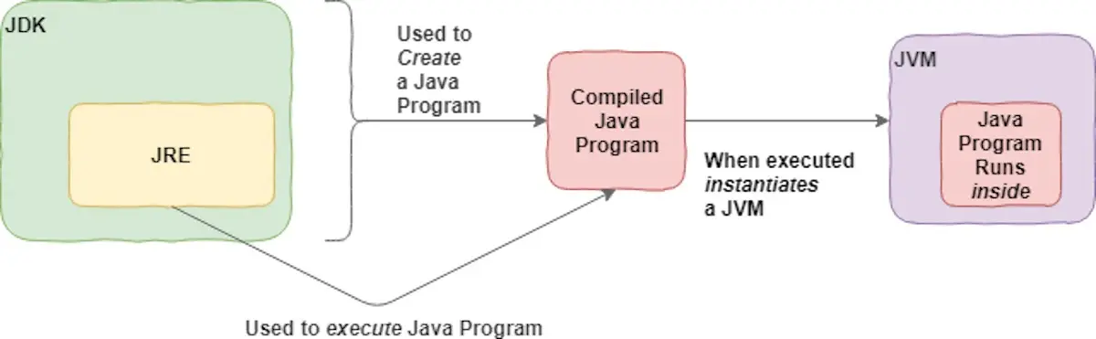

Slide 12
Heap Memory
It is created when the JVM starts up and used by the application as long as the application runs. It stores objects and JRE classes. Whenever we create objects it occupies space in the heap memory while the reference of that object creates in the stack.

Slide 13
Thank you
Manoj Hankare

